Slide 1

Software Engineering I Course Overview
Dr. Elham Mahmoudzadeh
Isfahan University of Technology
mahmoudzadeh@iut.ac.ir
1403-1, 2024

Slide 2
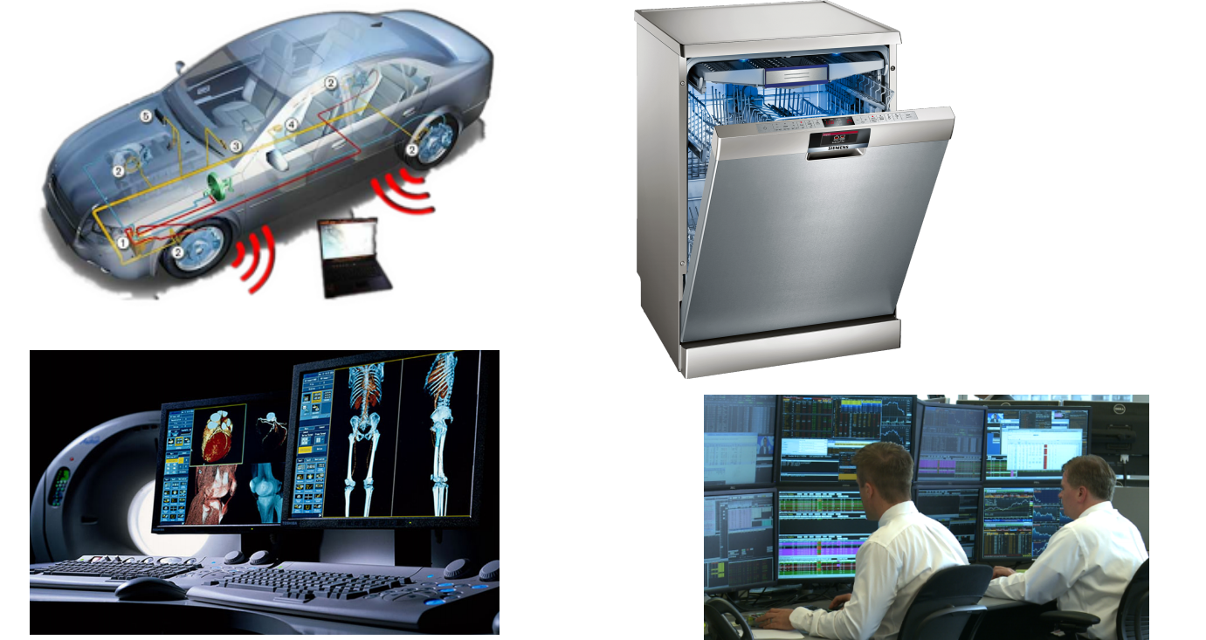

Software in modern world

Slide 3
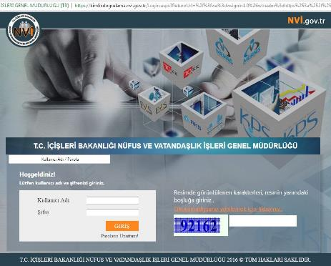
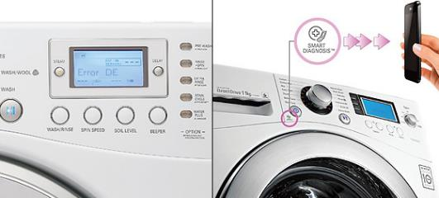
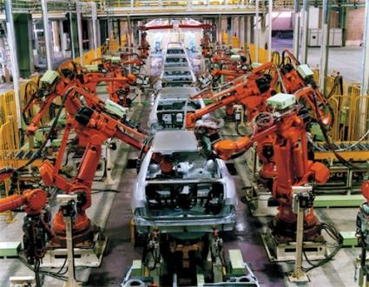

Software in modern world

Slide 4

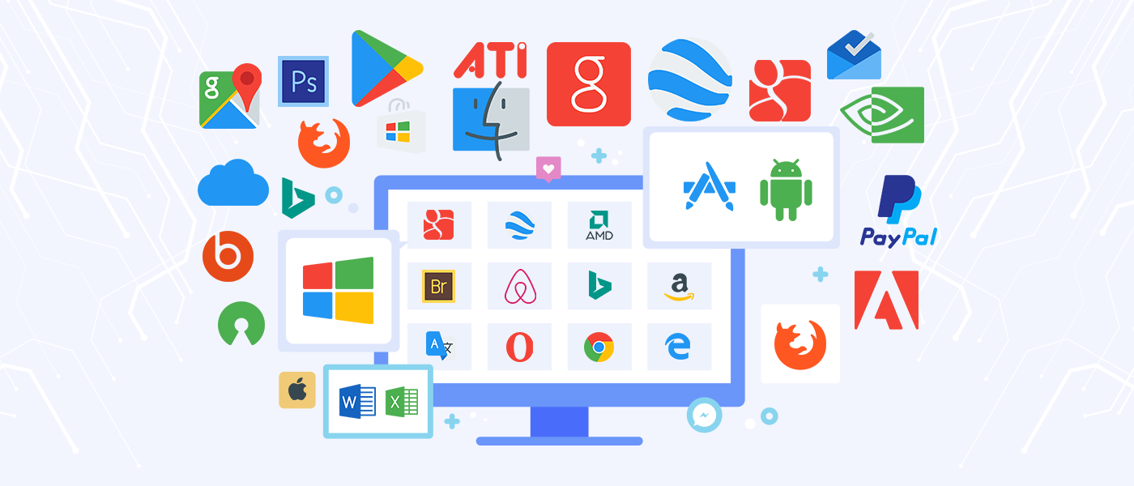
Software in modern world

Slide 5
We can’t run the modern world without software
National infrastructures and utilities are controlled by computer-based systems.
Most electrical products include a computer and controlling software.
Industrial manufacturing and distribution is completely computerized.
Entertainment, including computer games, and film and television, is software intensive.

Slide 6
References
1- Dennis, Wixon, Roth, “Systems Analysis and Design, 8th Edition, 2021.
2- Dennis, Wixon, Tegarden, “System Analysis and Design, An Object Oriented Approach with UML”, 5th Edition, 2015.
3- R. S. Pressman, B. R. Maxim, “Software Engineering, A Practitioner’s Approach”, 8th Edition, 2015.
4- Sommerville, I., “Software Engineering”, 10th Edition, 2015.
5- J. Sutherland, “Scrum handbook,” 2010.

Slide 7
Table of Contents
Introduction to System
Software Development Life Cycle
Software development methodologies
RUP and Agile
Scrum
Software Analysis
Software Design

Slide 8

Grading Policy
$50±5$% on project.
$35±5$% on midterm and Final exam.
$5 ±5$% on Class Activities.
$10±5$% on Presentation.
Late policy:·no credit for late work.

Slide 9
Course Overview
Course is actually three courses in one.
Object-oriented approach
Software analysis and design
Team working

Slide 10
You will learn…
How to design software using some powerful abstraction mechanisms and a collection of patterns;·how to get it right, by construction and by modular reasoning;·how to articulate your design ideas and critique other people’s designs;
And on the way:·
How to think about a problem.
How to translate customer needs into diagrams.
How to analysis the models and try to improve them.
How to work in a team.

Slide 11
What we expect from you
Attend in the lab;
Attend lectures;
Present your proposal;
Attend project reviews;
Complete project activities;
Help your team;

Slide 12
And what you expect from me?

Slide 13
Course goals
Think about the problem.
Software Analysis.
Design graphical user interfaces
Work suitable in a team.

Slide 14
Life strategy
Think in advance: don’t rush to code·
Design is more fun than debugging!·
Focus on ideas·
Don’t be blinded by technology·

Slide 15
For the next week
Form a group with three or four members.
Imagine your group as a company, select a name.
Think about your project.

Slide 16
What we will talk about next…
Introduction
How to write a proposal.

Slide 17
THANKS!

